Slide 1
SHOULD WE DECRIMINALIZE DRUGS?
(and why the answer is “YES”)

Slide 2



The decriminalization of drug use benefits everybody.
One in ten people have abused drugs in the past month.

Slide 3
BENEFITS OF DECRIMINALIZING DRUGS
* Improve public health
* Save many lives
* Decrease spending
* Increase revenue

Slide 4
WHAT IS (AND ISN’T DECRIMINALIZATION?


buying
selling
using in public
recreational use

Slide 5
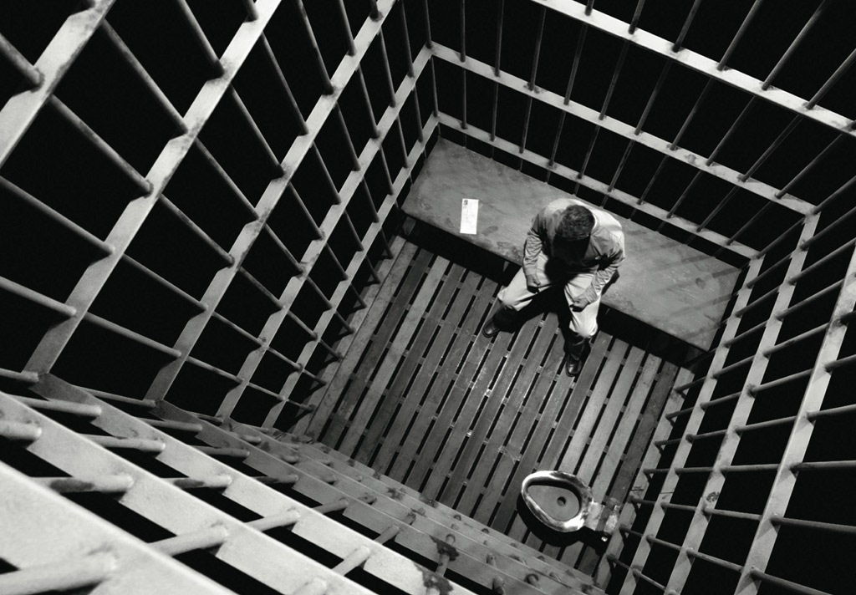
Make HEALTH the Priority
make addiction about TREATMENT instead of LEGALITY
MINIMUM PENALTIES (N.J.)
50 g or less
- 6 months jail
- $1000 fine
more than 50g
- 18 months prison
- $25,000 fine

Slide 6
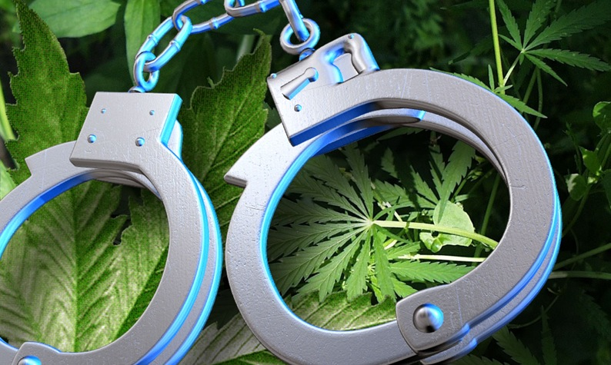


Decriminalization of Drug Use will SAVE LIVES
Accidental Deaths
drug overdoses > car crashes
because FEAR of
police involvement

Slide 7
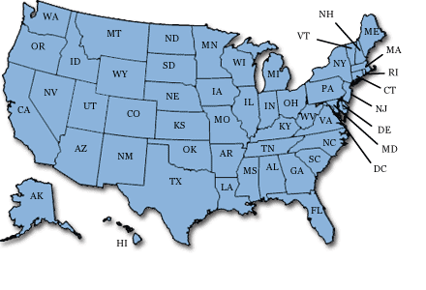
37 states plus D.C.
protect overdose victims and 911 callers helping them.
buying/selling are not exempt charges.

Slide 8

ECONOMIC EFECTS
Spending  Revenue 
$1 in treatment saves $5.60
- fewer arrests and incarcerations
- decreased medical costs
- less food stamp use and child welfare

Slide 9
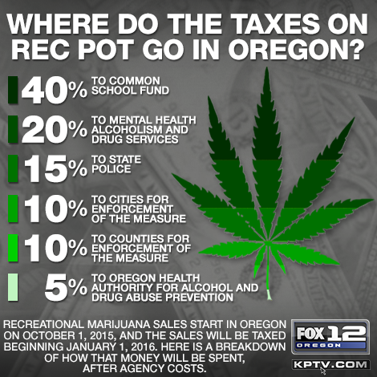
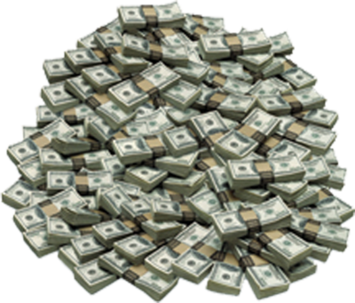

OREGON LEGALIZED AND TAXES WEED
Began 25% tax in January 2016
$2 M to $3 M expected over 12 months
$3.48 M for January alone

Slide 10
DECRIMINALIZATION OF DRUG USE
Addicts ≠ Criminals
Benefits EVERYONE
Improve Health
Save Lives
Less Money Out
More Money In

